Slide 1
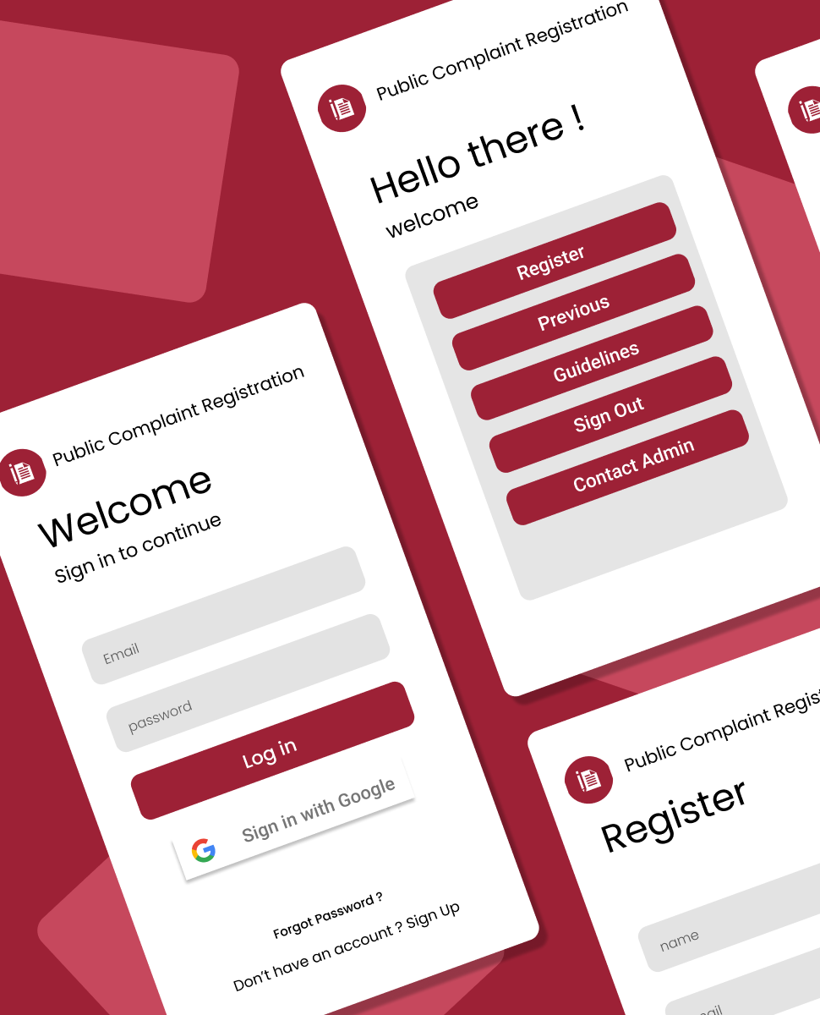

ONLINE COMPLAINT REGISTRATION & MANAGEMENT SYSTEM
Mern stack powered by mongodb

Slide 2
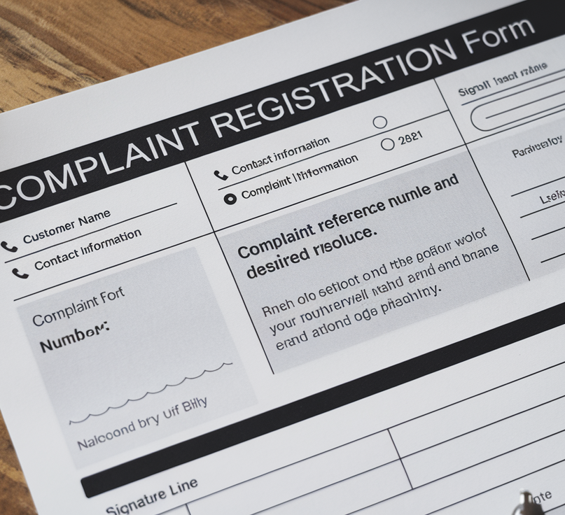
AGENDA
Introduction
Background
Generative AI Techniques for QR Code Generation
Advantages of Using Generative AI for QR Code Generation
Challenges and Considerations
Future Prospects and Research Directions
Conclusion

Slide 3

INTRODUCTION
The Online Complaint Registration and Management System is a modern, fully integrated web-based platform designed to streamline and automate the process of registering, managing, and resolving customer complaints. This system leverages the power of the MERN Stack (MongoDB, Express.js, React, Node.js) to offer a scalable, flexible, and responsive solution for handling customer service requests.
In traditional systems, complaints are often logged manually, causing delays in tracking, assigning, and resolving issues. This online system addresses these challenges by centralizing all complaint data, improving the workflow, and offering real-time updates, enhancing the overall customer experience.

Slide 4
BACKGROUND
The growing demand for efficient customer service management and the need to handle complaints quickly and transparently have led to the development of digital solutions that automate and streamline these processes. As businesses and organizations continue to embrace technology, it has become essential to integrate automated complaint management systems that provide real-time tracking, clear communication, and efficient workflows.
Methods: The system follows a three-layer architecture: the Frontend, Backend, and Database layers. Each layer is designed to work cohesively to ensure smooth and efficient functioning.

Slide 5
BACKGROUND
FRONTEND: The React framework is used for building the user interface, offering a modular, maintainable, and scalable structure. React’s component-based architecture enables easy development and maintenance of UI elements, while its Single-Page Application (SPA) model ensures a seamless, fast user experience.
BACKEND: Built using Node.js and Express.js, the backend is designed to handle user requests and manage data efficiently. JWT (JSON Web Token) is used for secure authentication, ensuring that only authorized users can access specific features based on their role (e.g., user, admin, agent).
DATABASE: The system uses MongoDB, a NoSQL database that offers flexibility and scalability for managing large datasets. MongoDB’s document-oriented structure is well-suited for storing user and complaint information

Slide 6
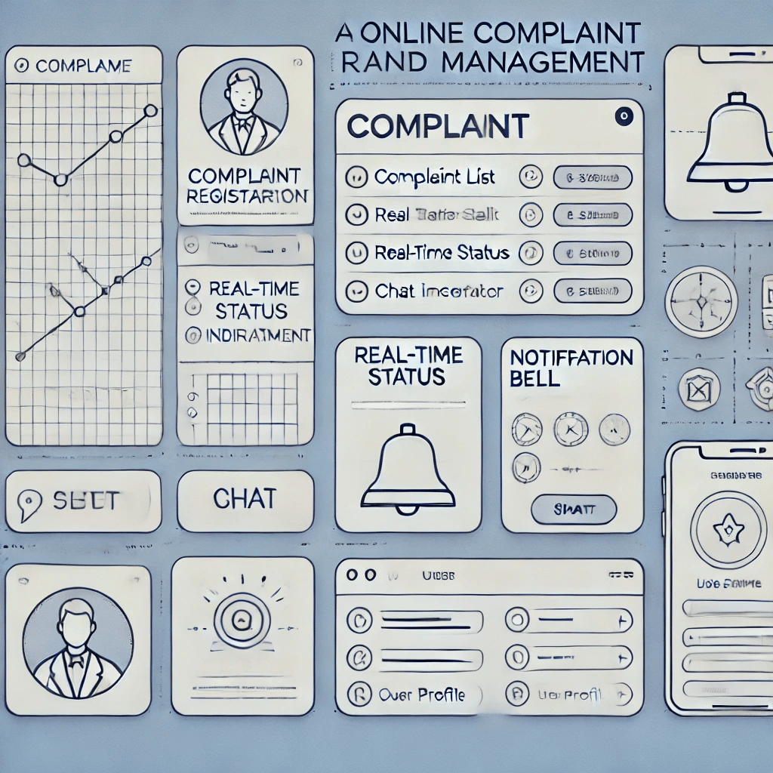
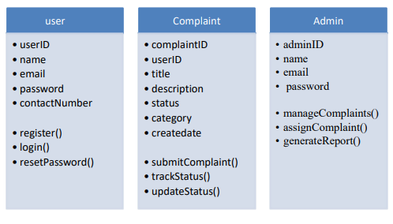
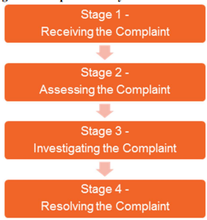
CLASS & STATE DIAGRAM

Slide 7

PROBLEM STATEMENT
In many organizations, managing customer complaints is still largely a manual and fragmented process, leading to inefficiencies and delays. Traditional methods, such as email or phone-based reporting, lack the infrastructure for centralized tracking and real-time updates. This results in lost complaints, slow response times, and poor customer satisfaction.
Furthermore, without a dedicated system, complaints often get overlooked or mishandled, leading to a lack of accountability among service agents and administrators. As a result, users are left without clear visibility on the status of their complaints, which erodes trust in the company's ability to resolve issues efficiently.

Slide 8

PROBLEM OVERVIEW
Traditional complaint handling methods often result in lost or unresolved issues, poor communication between users and administrators, and lack of real-time tracking. For administrators and agents, manually handling and prioritizing complaints can lead to errors and missed deadlines, affecting overall customer satisfaction and operational efficiency.
An integrated Online Complaint Registration and Management System can centralize all complaints, enabling users to submit and track their complaints in real-time. For administrators, it offers an organized way to monitor, assign, and resolve complaints efficiently.

Slide 9

End Users
Customers/Consumers:
Individuals who experience issues with products or services provided by a business or organization.
Customer Support Teams:
Customer service representatives who handle complaints from submission to resolution.
Business Administrators/Managers:
Internal stakeholders such as managers or supervisors who oversee the entire complaint management process.
Customer Service Agents:
They interact with customers to address issues, update complaint statuses, and close the complaints once resolved.
IT or System Admins:
Technical staff responsible for maintaining the system, ensuring its functionality, managing security, and performing updates.

Slide 10
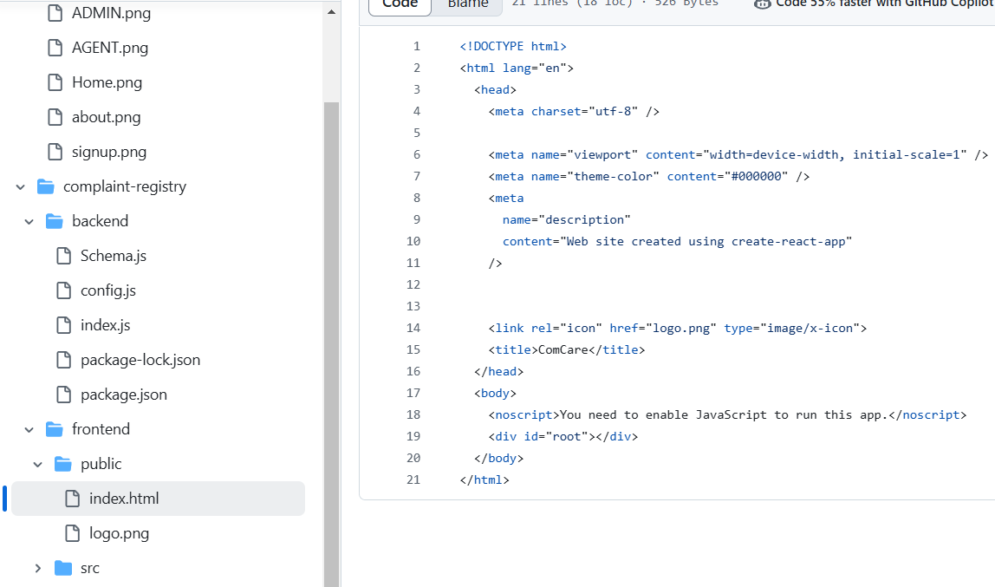
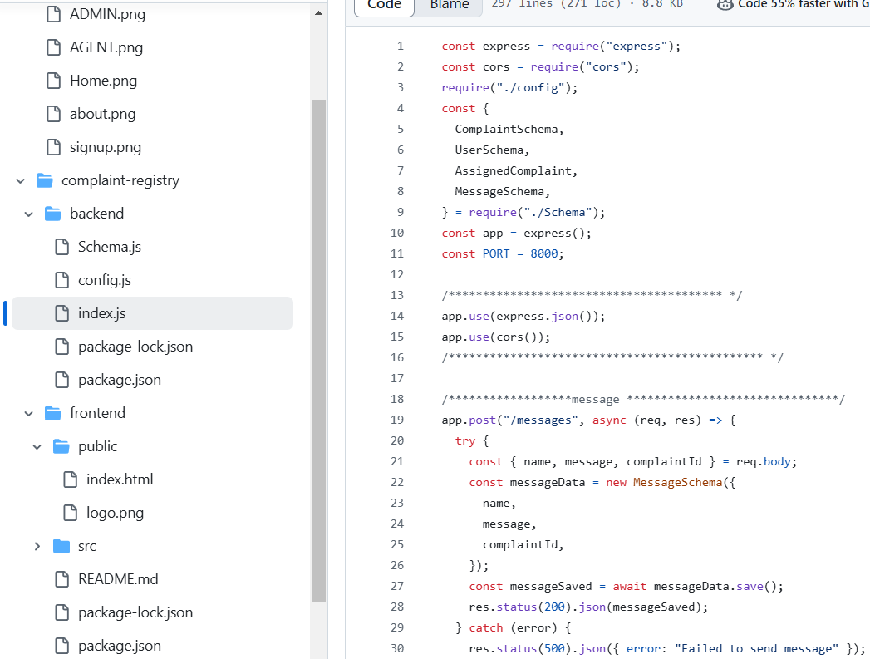
RESULTS

Slide 11


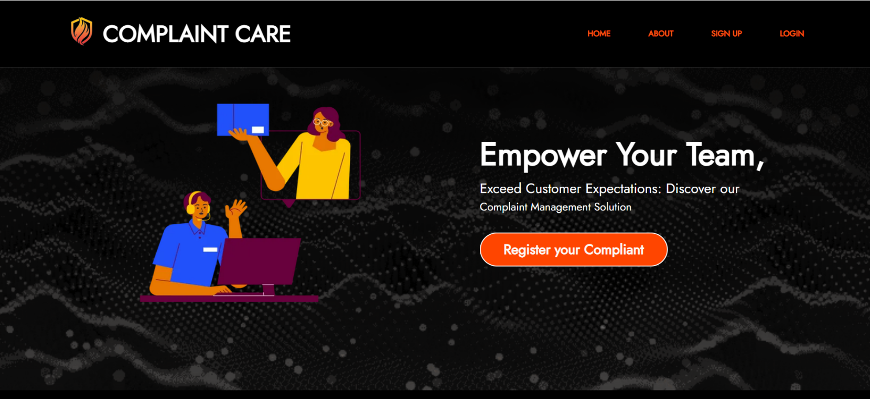
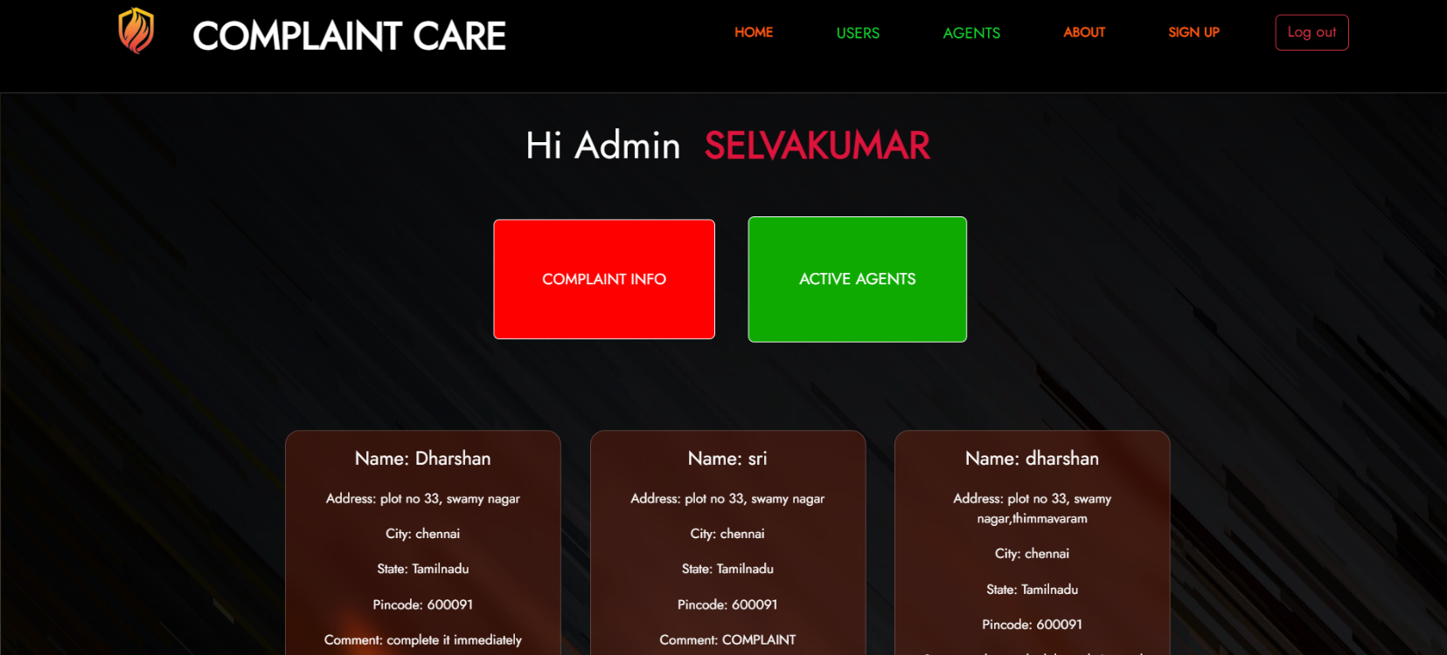
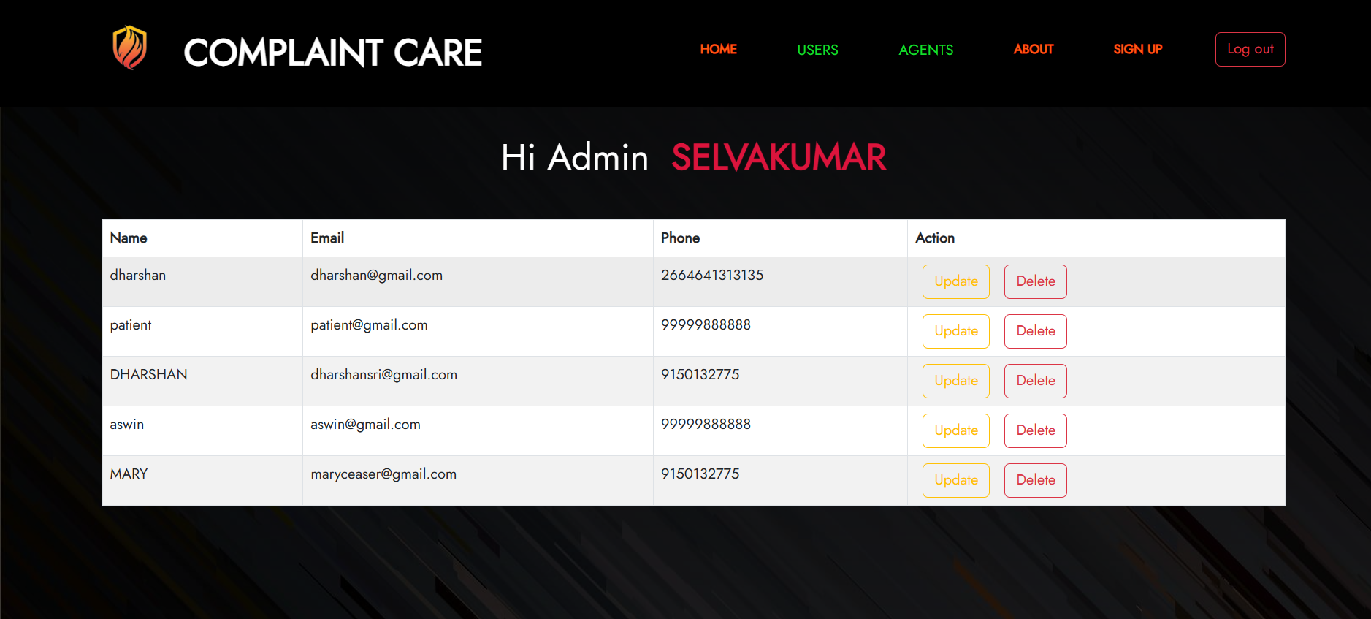
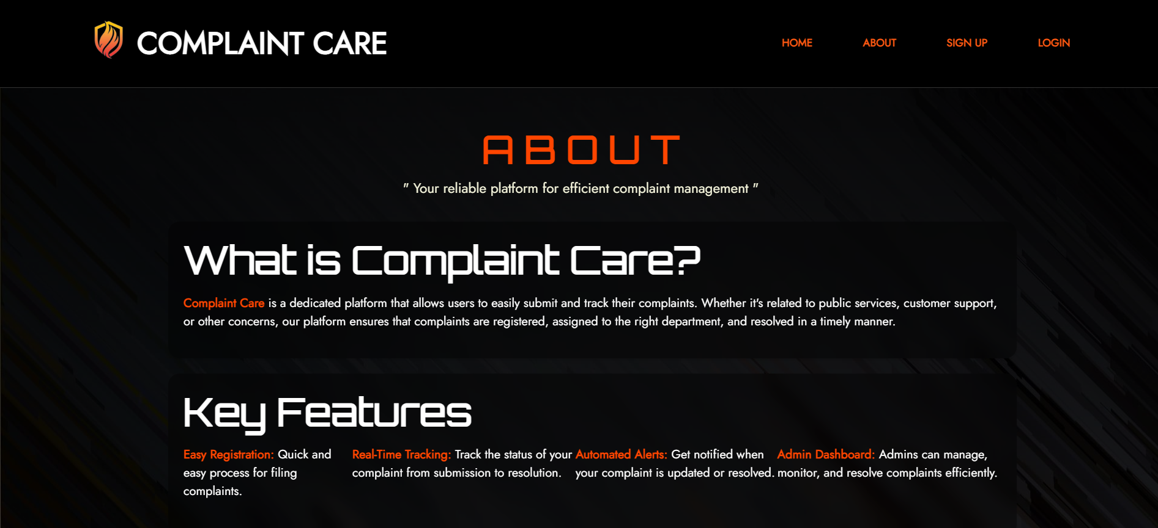
RESULTS

Slide 12
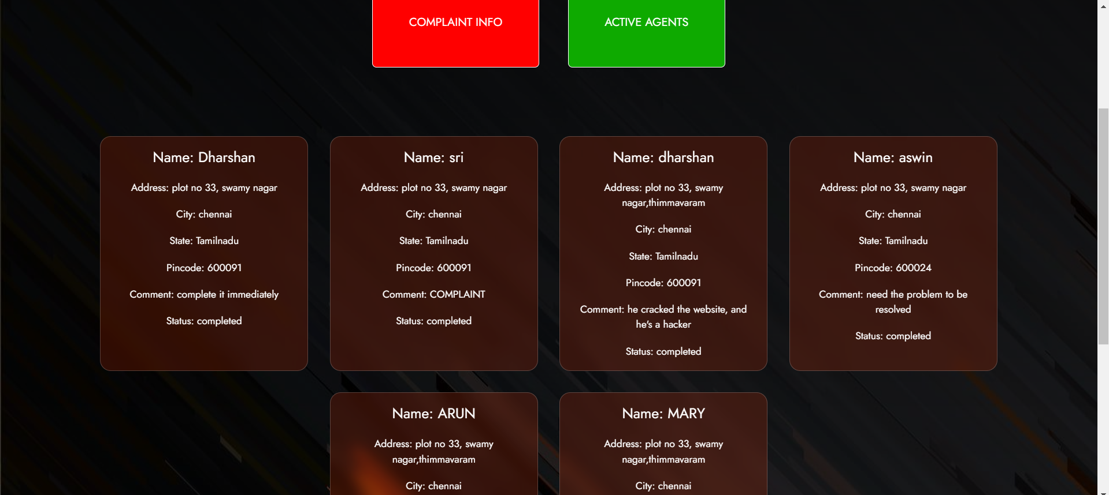
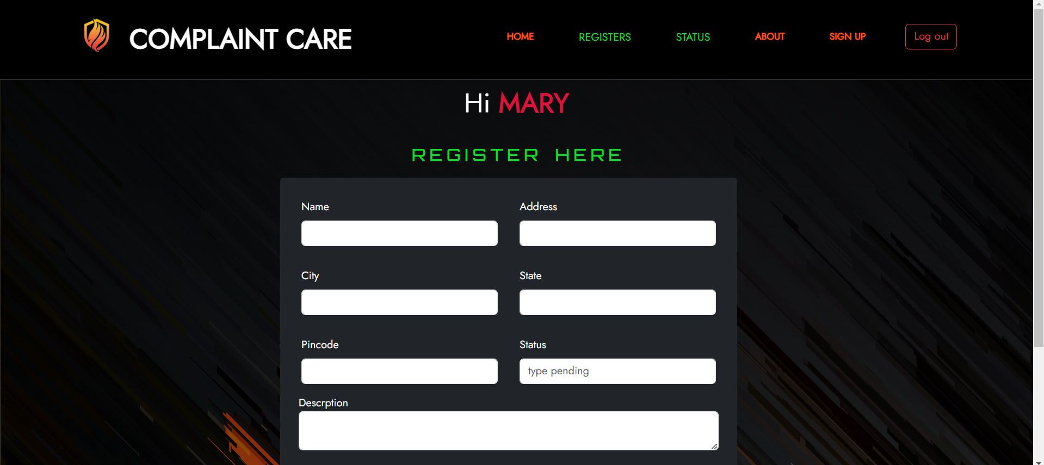
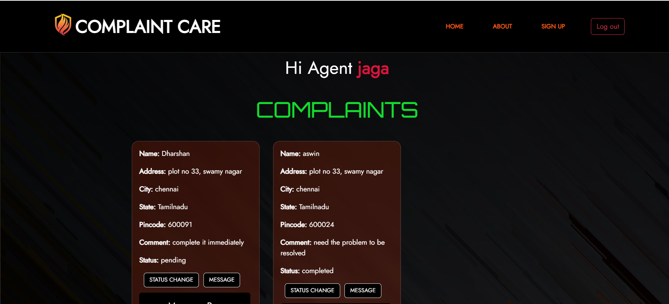

RESULTS

Slide 13
ADVANTAGES
Improved Efficiency:Streamlines the complaint process, reducing manual tasks and speeding up resolution through automation.
24/7 Accessibility:Web-based system allows users to submit and track complaints anytime, from anywhere.
Transparency and Accountability:Real-time status tracking fosters transparency and ensures accountability for both users and administrators.
Centralized Complaint Management:A single database helps admins efficiently manage, prioritize, and assign complaints.
Enhanced Communication:Real-time notifications and email updates keep users and admins informed on complaint progress.
Data Analytics and Reporting:Generates reports to analyze trends, resolution times, and satisfaction, improving service quality.
Improved Customer Satisfaction:Faster resolution, transparency, and clear communication lead to higher user satisfaction.

Slide 14

Challenges and Considerations
Data Security & Privacy: Protecting sensitive user data through encryption, secure authentication, and compliance with privacy regulations.
Scalability: Ensuring the system can handle increased traffic and data efficiently as the user base grows.
User Adoption: Overcoming resistance to online complaint submission through a user-friendly interface and clear communication.
Integration with Existing Systems: Addressing compatibility and seamless data integration with current enterprise systems.
System Downtime & Maintenance: Minimizing downtime with regular maintenance and robust backup processes to maintain user trust and service quality.
QR CODE GENERATION

Slide 15

Future Enhancements
Integration with Social Media and Third-Party Platforms: Enable users to submit complaints via social media (e.g., Twitter, Facebook) or messaging platforms (e.g., WhatsApp) for wider accessibility and real-time resolutions.
AI-Based Complaint Categorization and Prioritization: Implement machine learning to automatically categorize and prioritize complaints, ensuring faster response to critical issues.
Real-Time Chat Support: Add live chat functionality for real-time communication between users and admins, improving resolution times for urgent complaints.
Multilingual Support: Introduce multilingual support to cater to users from diverse linguistic backgrounds, improving system accessibility.

Slide 16
CONCLUSION
The Online Complaint Registration and Management System offers an efficient, scalable solution for managing customer complaints, improving both user experience and organizational operations. By enabling easy complaint submission, tracking, and resolution, the system ensures transparency and accountability.
The integration of advanced technologies like AI, real-time updates, and mobile access enhances the functionality, making it adaptable for future growth. Despite some challenges, such as data security and system integration, the platform holds immense potential to streamline customer service processes, increase satisfaction, and contribute to overall business success.
Source code @github: https://github.com/SELVAENGINER/MERN_STACK

Slide 17

T H A N K Y O U

